Slide 1

First Steps:
February 8, 2017
Meeting No. 18

Slide 2


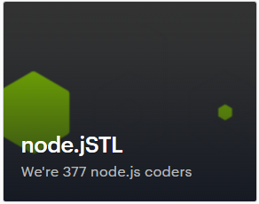
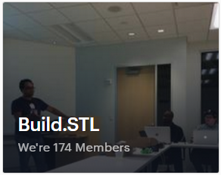
What Others Are Doing….
“Inaugural Web Design & Dev Meetup”
Feb 16 (Thu) • 6 pm
OCI Education Center • 12140 Woodcrest Exec Dr
“Live Like a Hippy – First StL Elixir Meetup”
Feb 20 (Mon) • 6 pm
Asychrony • 900 Spruce St
“Testing, Mocha, Chai, and you!”
Feb 21 (Tue) • 6 pm
CIC@CET
To Be Determined
March, tentative
CIC • 4240 Duncan Ave

Slide 3
Welcome!
About Us: Learning how to create full-stack, scalable internet applications. From the database… all the way to the front-end user interface : JavaScript Frameworks ∙ Server-Side Code ∙ Load Balancing
Meetup Calendar:
https://www.meetup.com/SaintLouis_FullStack_WebDevelopment/events/
Slack Group(s):
https://stl-tech.slack.com/messages/stl_fullstack_web_dev/

Slide 4




NoSQL: In Brief….
Mid 2000’s …. Web 2.0 includes:
Larger Data Sets
Variety of Data
Real-Time Processing
Horizontal Scalability
Rapid Development and Flexibility
“Not Only SQL”
RDBMS:
The “Old” Guard…

Slide 5


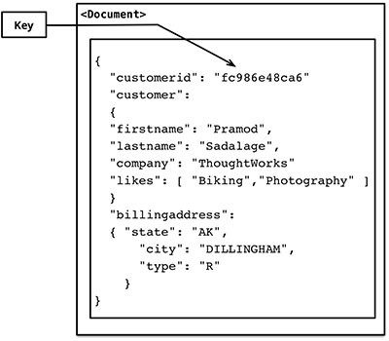
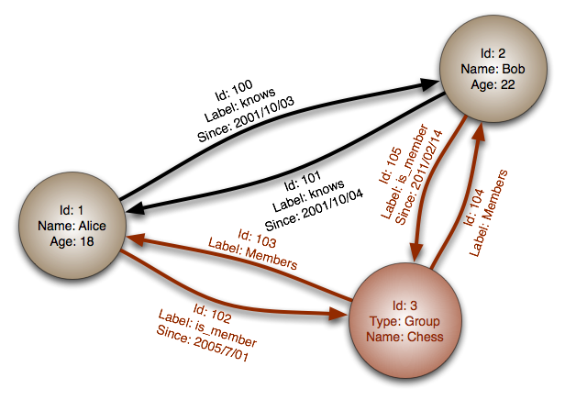






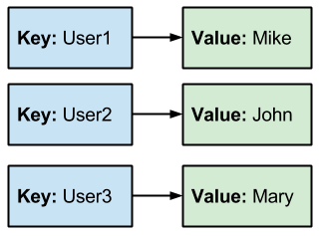

NoSQL: Key Players
Document
Graph
Object-Oriented
Nested Entities
Relationships in Data
Traversals
Columnar
Key Value
Analytical Processing
Few Fields … Many Rows
Fast Reads
Simple Use Cases

Slide 6
NoSQL: Key Players
Document
Graph
Object-Oriented
Nested Entities
Relationships in Data
Traversals
Columnar
Key Value
Analytical Processing
Few Fields … Many Rows
Fast Reads
Simple Use Cases

Slide 7
What is Redis?
REmote DIctionary Server
In-memory Key Value Store … with Persistence (Storage)
1M Small Keys (String Values) ~ 100MB
1M Keys (Hash Values… 5 Fields) ~ 200MB
Multiple Data Types… Multiple Use Cases
Strings… Hashes… Lists…. And More!
Benefits:
Improved Response Times
Fast Development
High Availability … Clustering … Security (basic)

Slide 8

Disadvantages?
Data Must Be Smaller Than Memory
Tighter Coupling b/w Application and Database
Limited Security (again …basic)
Memory Costs …. $$$ !!
Some “Normal” DB Features Not Included

Slide 9
Use Cases
User Session Management
Static HTML Cache
Leaderboards
Most Recent Posts
Real-Time Analytics

Slide 10





Architecture
1. Single Instance
2. Master/Slave
3. Cluster

Slide 11
Configuration
/etc/redis/redis.conf
Primary (Only?) Configuration File
/etc/redis/sentinel.conf
Built-in High Availability Solution

Slide 12

5 Basic Data Types
Strings
Hashes
Lists
Sets
Sorted Sets
Bitmaps
Space Efficient
Storage of 1’s & 0’s
We’re Data Types too! … Kinda
Hyperloglog
Estimates Counts of
Big Data Sets

Slide 13
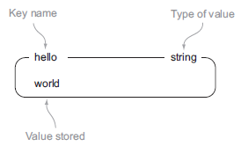
Data Types : Strings
Redis’ most basic data type
Strings, Integers, Floating-Point Values
USE CASE: Scalar Values; Images; Static HTML
Command | What It Does | Format
SET | Sets the value stored at a key | SET [key] [val]
GET | Gets the value from a key | GET [key]
APPEND | Appends to existing value or sets it | APPEND [key] [val]
SETNX | Sets the value only if it doesn’t exist | SETNX [key] [val]
INCR | Increments the value by 1 | INCR [key
INCRBY | Increments the value by a given amount | INCRBY [key] [amount]
MSET | Sets multiple key-value pairs at once | MSET [key1] [val1] [key2] [val2]
DEL | Deletes the value from a key | DEL [key]

Slide 14
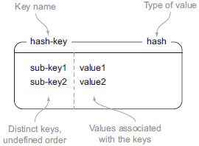
Data Types : Hashes
Unordered table of attributes and values
USE CASE: Simple Documents and Objects
Command | What It Does | Format
HSET | Sets the value stored at a sub-key | HSET [hash-key] [key] [val]
HGET | Gets the value from a sub-key | HGET [hash-key] [key]
HLEN | Gets the number of sub-keys for a key | HGETALL [hash-key]
HEXISTS | Checks for existence of a sub-key | HEXISTS [hash-key] [key]
HMSET | Sets multiple sub-key-value pairs at once | HMSET [hash-key] [key1] [val1] [key2] [val2]
HVALS | Gets all the values from a key | HVALS [hash-key]
HKEYS | Gets all the sub-keys from a key | HKEYS [hash-key]
HDEL | Deletes the value from a sub-key | HDEL [hash-key] [key]

Slide 15
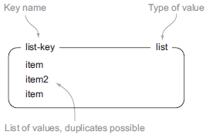
Data Types : Lists
Linked List of Strings; Head/Tail Operations
USE CASE: Most Recent Items
Command | What It Does | Format
LPUSH | Prepends the value to the list from the left | LPUSH [list-key] [val]
RPUSH | Prepends the value to the list from the right | RPUSH [list-key] [val]
LPOP | Removes the first value from the list | LPOP [list-key]
LRANGE | Gets the sub list of values based on the range | LRANGE [list-key] [start] [end]
LINSERT | Inserts a value after the position listed | LINSERT [list-key] AFTER [val] [new]
LSET | Sets the value at the position listed | LSET [list-key] [val]
LREM | Removes the value specified | LREM [list-key] [# of copies] [val]
LTRIM | Removes all values outside of the range | LTRIM [list-key] [start] [end]

Slide 16
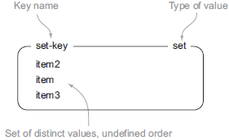
Data Types : Sets
Unordered Collection of Unique Strings
USE CASE: Set-based Operations
Command | What It Does | Format
SADD | Adds value to a set | SADD [set-key] [val]
SMEMBERS | Gets all values in a set | SMEMBERS [set-key]
SRANDMEMBER | Gets one or more random values | SRANDMEMBER [set-key] [# of values]
SPOP | Removes and returns a random value | SPOP [set-key]
SUNION | Combines multiple sets | SUNION [set-key1] [set-key2]
SDIFF | Gets values from 1st set not in 2nd set | SDIFF [set-key1] [set-key2]
SINTER | Gets values in both 1st and 2nd sets | SINTER [set-key1] [set-key2]
SINTERSTORE | Stores results of SINTER into a new set | SINTERSTORE [new set] [set-key1] [set-key2]

Slide 17
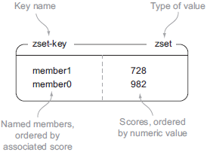
Data Types : Sorted Sets
Collection of Distinct Strings Ordered By Score
USE CASE: Leaderboards
Command | What It Does | Format
ZADD | Adds a value to a sorted set | ZADD [zset-key] [score] [value]
ZRANGE | Gets values based on ranking | ZRANGE [zset-key] [start] [end]
ZREVRANGE | Gets values in reverse ranking | ZREVRANGE [zset-key] [start] [end] WITHSCORES
ZSCORE | Gets the score of the value | ZSCORE [zset-key] [value]
ZCOUNT | Gets the values in a score range | ZCOUNT [zset-key] [start] [end]
ZRANGEBYSCORE | Gets values based on score | ZRANGEBYSCORE [zset-key] [start] [end]
ZINTERSTORE | Stores results of ZINTER into a new set | ZINTERSTORE [zset-key] [start] [end]

Slide 18
Persistence
Not Just Memory (unlike Memcached)
Only Used For Recovery…. NOT Retrieval!!
2 Types:
RDB – Takes a snapshot of entire dataset periodically
Pro’s: Good for Backup and Faster Recovery… Minimal Performance Drain
Con’s: Possible Data Loss
AOF – Appends each write command to disk
Pro’s: More Durable… Options (1. No sync… 2. Every N sec… 3. Every Query)
Con’s: Files Larger Than RDB… Slower Performance

Slide 19
Other Features
Transactions
Sentinel
PubSub
Lua Scripting
Bitmaps
HyperLogLog

Slide 20
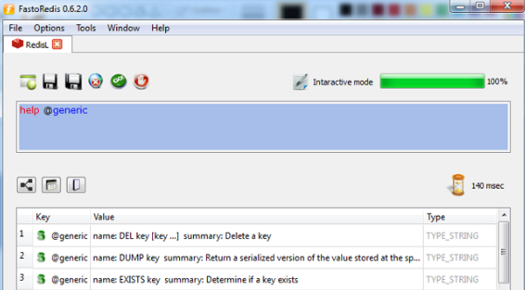
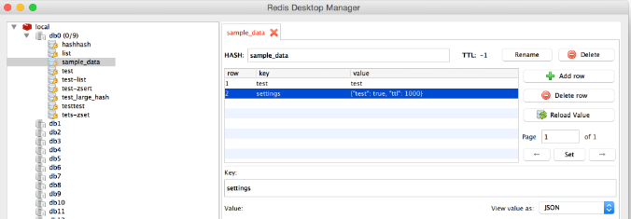
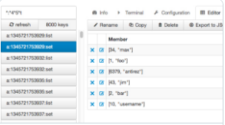
Redis Tools
Tool | Purpose
redis-cli monitor | Debugging tool; streams back every command on the server
slowlog | Log queries that exceed a specified execution time
redis-benchmark | Simulates commands run by N clients at the same time
INFO Command | Info and stats about the server; easy to read and parse
http://fastoredis.com/
https://redisdesktop.com/
https://www.redsmin.com/

Slide 21

To The Terminal!

Slide 22
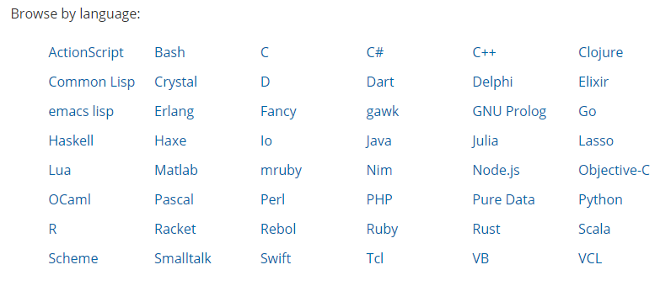
Redis Clients
https://redis.io/clients

Slide 23
Redis Clients
https://redis.io/clients

Slide 24
Possible Next Steps
Advanced Features and Best Practices
Performance Testing w/ Redis Tools (Benchmark, etc.)
Chat Room Functionality
Session Management

Slide 25
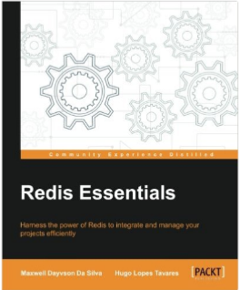
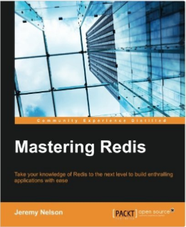

Redis Resources
https://www.udemy.com/getting-started-with-redis
https://redis.io/documentation
https://redis.io/commands
https://matt.sh/what-is-redis

